Slide 1
Robotics and Machine Intelligence
Week 3
Robotics and Machine Intelligence | Week 3

Slide 2
Robot Movement and Precision
Speed of response and stability are two important characteristics of robot movement.
Speed defines how quickly the robot arm moves from one point to another.
Stability refers to robot motion with the least amount of oscillation. A good robot is one that is fast enough but at the same time has good stability.
The precision of robot movement is defined by three basic features:
Spatial resolution
Accuracy
Repeatability
Robotics and Machine Intelligence | Week 3

Slide 3
Spatial Resolution
The spatial resolution of a robot is the smallest increment of movement into which the robot can divide its work volume. It depends on :
the system's control resolution and
the robot's mechanical inaccuracies.
Control Resolution
Control resolution is determined by the robot's position control system and its feedback measurement system. The controller divides the total range of movements for any particular joint into individual increments that can be addressed in the controller.
The bit storage capacity of the control memory defines this ability to divide the total range into increments.
For a particular axis, the number of separate increments is given by
Number of increments = 2^{n}
where n is the number of bits in the control memory.
Robotics and Machine Intelligence | Week 3

Slide 4
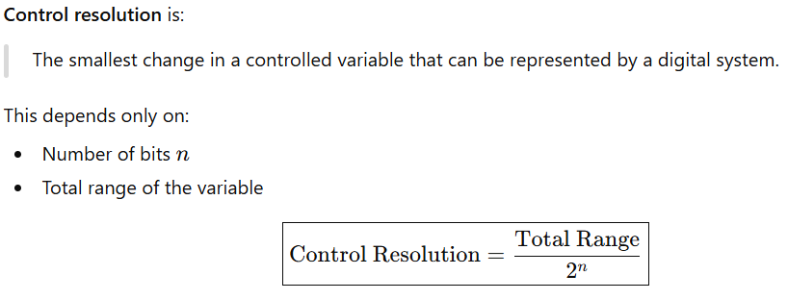
Control Resolution
Why Linear & Rotational Joints are Emphasized?
Robot motion is primarily described by position
Most industrial robots use prismatic (linear) and revolute (rotational) joints
Easy to visualize and test mathematically
Robotics and Machine Intelligence | Week 3

Slide 5
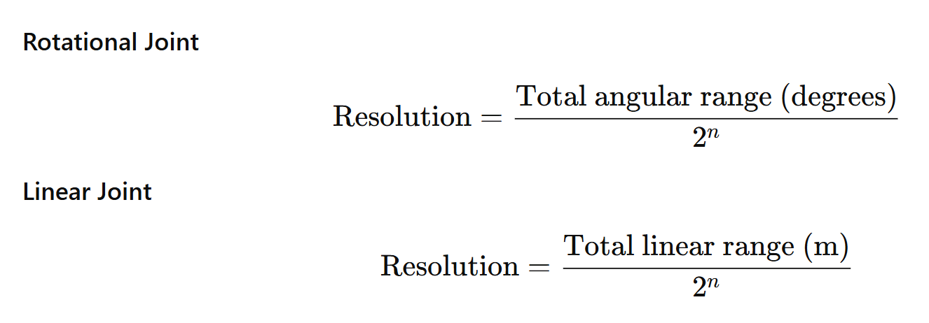
Control Resolution
Control resolution is the smallest change in joint position that can be commanded by a digital controller. It depends on:
Number of control bits
Total motion range of the joint
Robotics and Machine Intelligence | Week 3

Slide 6

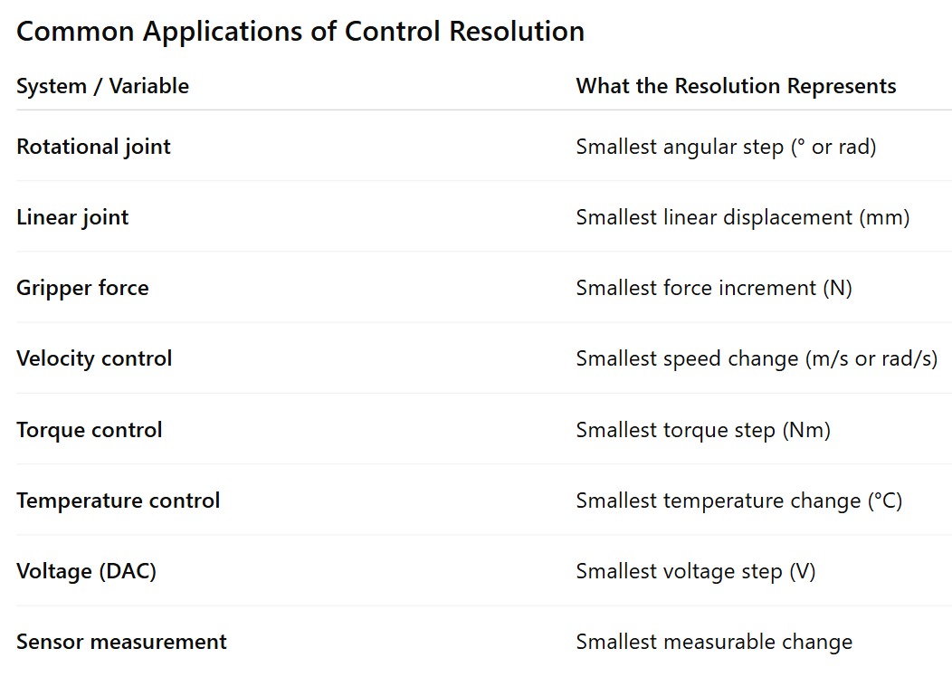
Robotics and Machine Intelligence | Week 3

Slide 7
EXAMPLE
A robot's control memory has 8-bit storage capacity. It has two rotational joints and one linear joint Determine the control resolution for each joint, if the linear link can vary its length from as short as 0.2 m to as long as 1.2 m.
Solution
Control memory = 8 bit
From the equation above, number of increments = 2⁸ = 256
(a) Total range for rotational joints = 360
Control resolution for each rotational joint = 360/256 = 1.40625
(b) Total range for linear joint = 1.2 - 0.2 = 1.0 m
Control resolution for linear joint = 1/256 = 0.003906 m = 3.906 mm
Robotics and Machine Intelligence | Week 3

Slide 8
Discussion
Agree? or Disagree?
Increasing the number of control bits always improves control resolution.
With the same number of bits, joints with larger motion ranges have poorer resolution.
Control resolution represents the fundamental precision limit of a digital controller.
Robotics and Machine Intelligence | Week 3
Notes:
✅ Agree (theoretically) More bits increase the number of discrete command levels, resulting in finer resolution. ⚠️ However, real systems are limited by noise, backlash, sensor resolution, and actuator dynamics.
✅ Agree Resolution = Range / 2^{n}. Larger range with same n → larger step size → poorer resolution.
⚠️ Partially agree Control resolution limits command granularity, but overall system precision may be worse due to mechanical and sensing errors.

Slide 9
Common Misconceptions
“Higher resolution means higher accuracy.” ❌
“If resolution is small enough, errors disappear.” ❌
“Two robots with the same controller bits have the same precision.” ❌
Robotics and Machine Intelligence | Week 3
Notes:
Resolution defines the smallest command step, not closeness to the true value.
Accuracy depends on calibration, sensors, and mechanics—not just bits.
Precision varies with range, gearing, encoders, and structure, even with identical controllers.

Slide 10
Exercise
A robot manipulator is controlled by a digital controller with a 10-bit control memory.
The robot has three joints:
Two rotational joints, each capable of rotating through 270°
One linear joint, whose length varies from 0.5 m to 1.5 m
Assuming the control memory is used independently for each joint, determine the control resolution for:
Each rotational joint (in degrees)
The linear joint (in millimetres)
Robotics and Machine Intelligence | Week 3

Slide 11
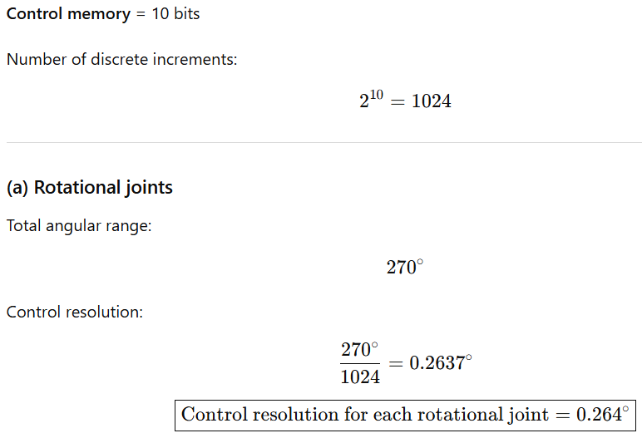
Exercise-Solution
Robotics and Machine Intelligence | Week 3

Slide 12
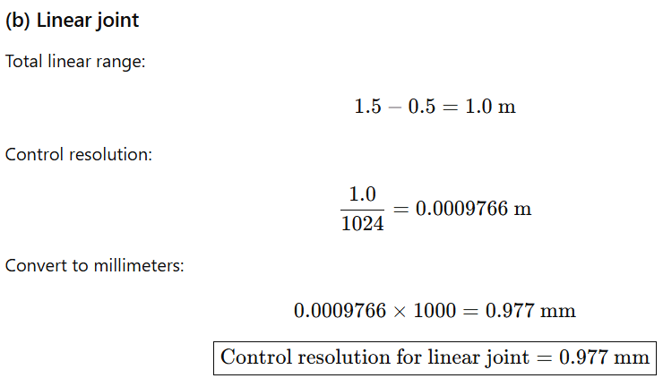
Exercise-Solution
Robotics and Machine Intelligence | Week 3

Slide 13
THE ROBOTIC JOINTS
A robot joint is a mechanism that permits relative movement between parts of a robot arm.
Degrees of Freedom (DOF)
The number of independent variables or parameters that can change in a system, like movement in 3D space (up/down, left/right, forward/backward) or rotational axes.
The joints of a robot are designed to enable the robot to move its end-effector along a path from one position to another as desired.
The basic movements required for the desired motion of most industrial robots are:
Rotational movement.- This enables the robot to place its arm in any direction on a horizontal plane.
Radial movement. This enables the robot to move its end-effector radially to reach distant points.
Vertical movement. This enables the robot to take its end-effector to different heights.
Robotics and Machine Intelligence | Week 3

Slide 14
THE ROBOTIC JOINTS
These degrees of freedom, independently or in combination with others, define the complete motion of the end-effector. These motions are accomplished by movements of individual joints of the robot aim.
The joint movements are basically the same as relative motion of adjoining links. Depending on the nature of this relative motion, the joints are classified as prismatic or revolute.
Prismatic joints are also known as sliding as well as linear joints. They are called prismatic because the cross section of the joint is considered as a generalized prism. They permit links to move in a linear relationship.
Revolute joints permit only angular motion between links.
Robotics and Machine Intelligence | Week 3

Slide 15
THE ROBOTIC JOINTS
Linear joint (L). The relative movement between the input link and the output link is a linear sliding motion, with the axes of the two links being parallel.
Orthogonal joint (O). This is also a linear sliding motion, but the input and output links are perpendicular to each other during the move.
Rotational joint (R). This type provides a rotational relative motion of the joints, with the axis of rotation perpendicular to the axes of the input and output links.
Twisting joint (T). This joint also involves a rotary motion, but the axis of rotation is parallel to the axes of the two links.
Revolving joint (V). In this joint type, the axis of the input link is parallel to the axis of rotation of the joint, and the axis of the output link is perpendicular to the axis of rotation.
Robotics and Machine Intelligence | Week 3

Slide 16
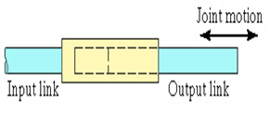
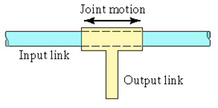
THE ROBOTIC JOINTS
TRANSLATIONAL MOTION
Linear joint (L)
Type L joint; the relative movement between the input link and the output link is a translational sliding motion, with the axes of the two links parallel.
Orthogonal joint (O)
Type O joint; the relative movement between the input link and the output link is a translational sliding motion, but the output link is perpendicular to the input link.
Robotics and Machine Intelligence | Week 3

Slide 17
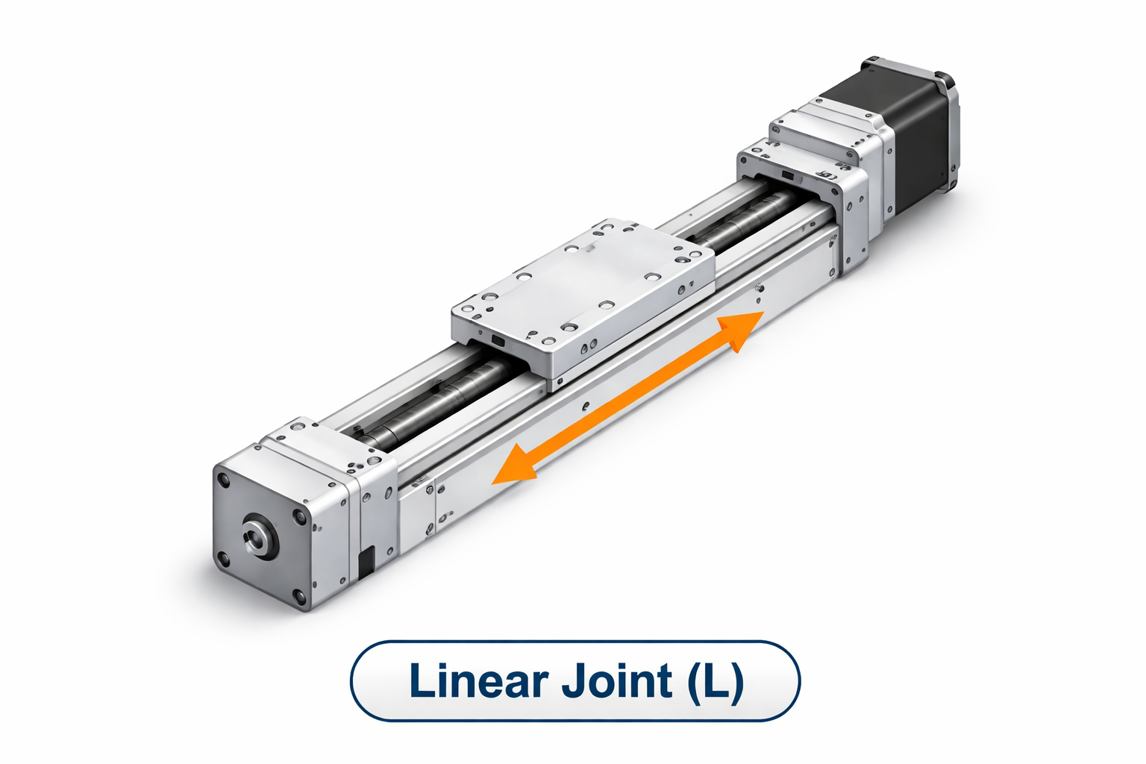
THE ROBOTIC JOINTS
Robotics and Machine Intelligence | Week 3

Slide 18
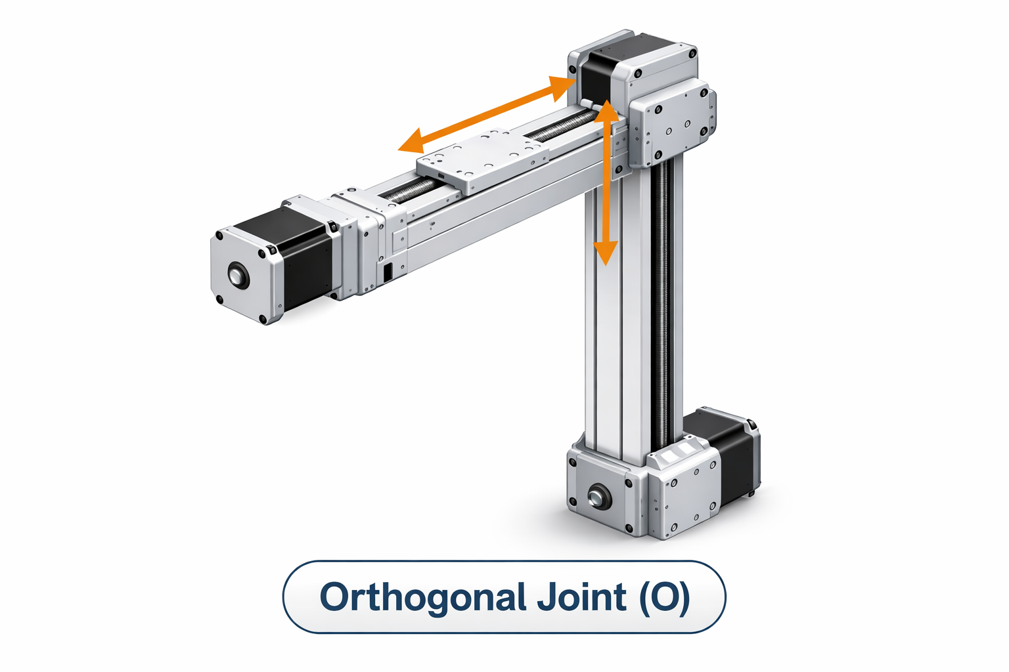
THE ROBOTIC JOINTS
Robotics and Machine Intelligence | Week 3

Slide 19
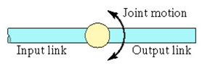
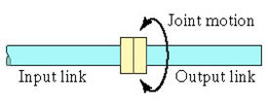
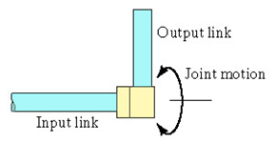
THE ROBOTIC JOINTS
ROTARY MOTION
Rotational joint (R)
Type R joint; this provides rotational relative motion, with the axis of rotation perpendicular to the axes of the input and output links.
Twisting joint (T)
Type T joint; this provides rotary motion, but the axis of rotation is parallel to the axes of the two links.
Revolving joint (V)
Type V joint; the axis of the input link is parallel to the axis of rotation of the joint, and the axis of the output link is perpendicular to the axis of rotation.
Robotics and Machine Intelligence | Week 3

Slide 20
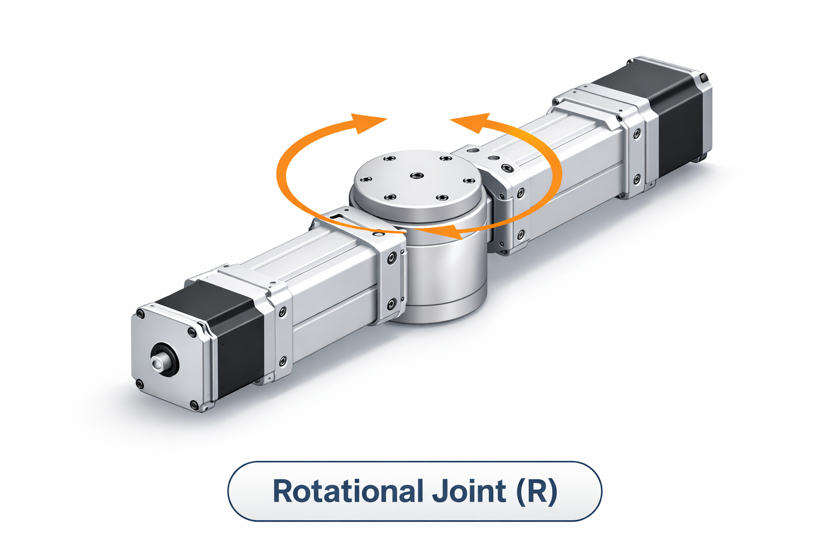
THE ROBOTIC JOINTS
Robotics and Machine Intelligence | Week 3

Slide 21
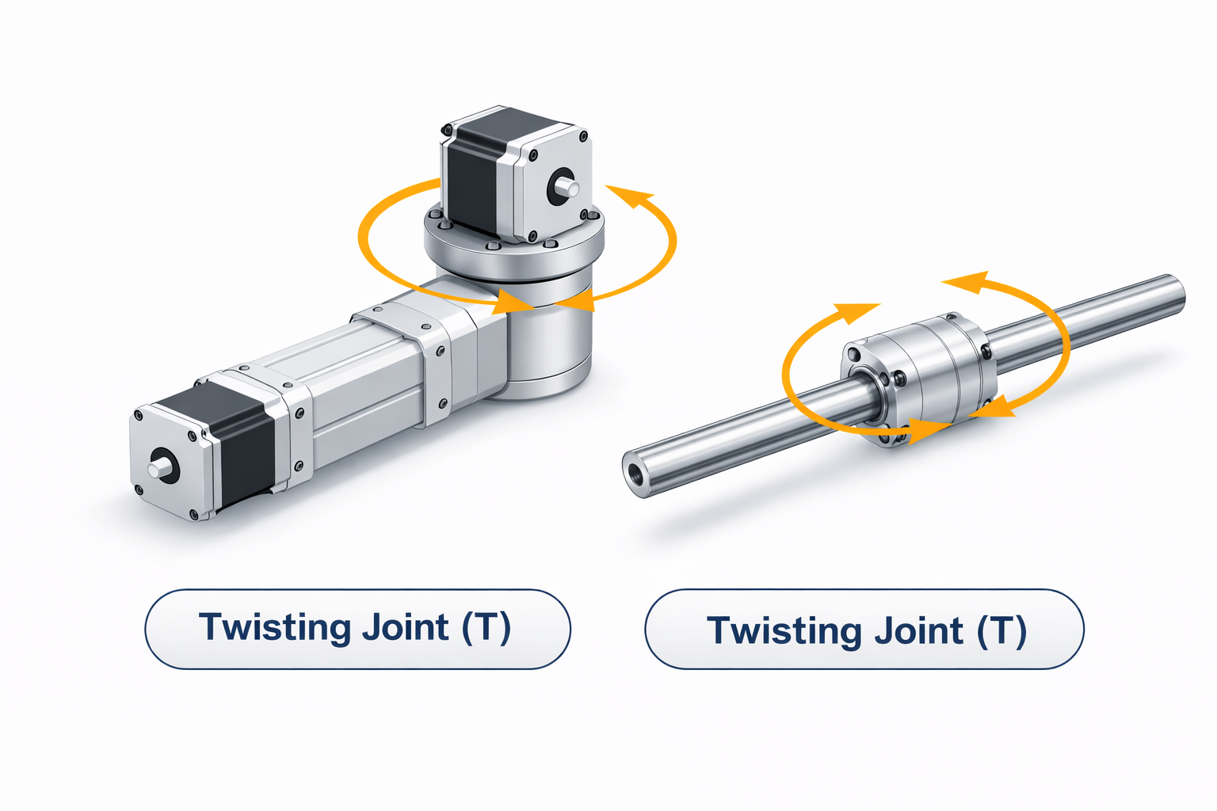
THE ROBOTIC JOINTS
Robotics and Machine Intelligence | Week 3

Slide 22
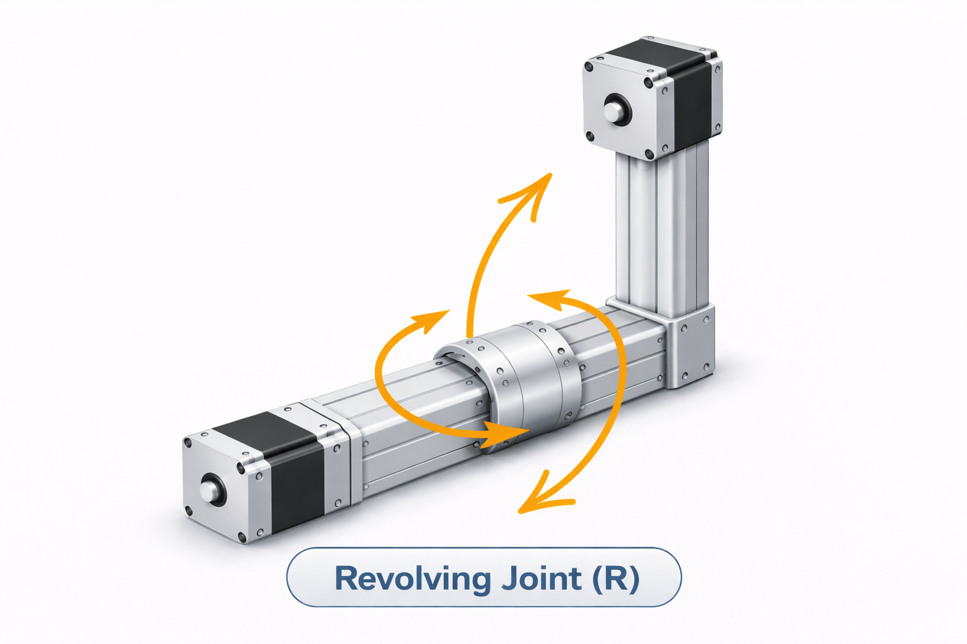
THE ROBOTIC JOINTS
Robotics and Machine Intelligence | Week 3

Slide 23
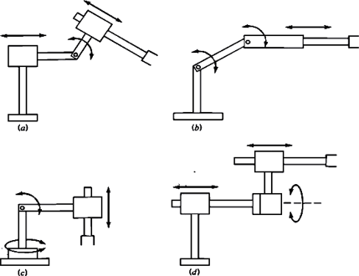
two forms of orthogonal and a rotational joint-type;
two forms of rotational and a linear joint-type;
Rotational, Twisting and orthogonal joint-type
Linear, Orthogonal, Twisting and Revolving joint-type
Robotics and Machine Intelligence | Week 3

Slide 24
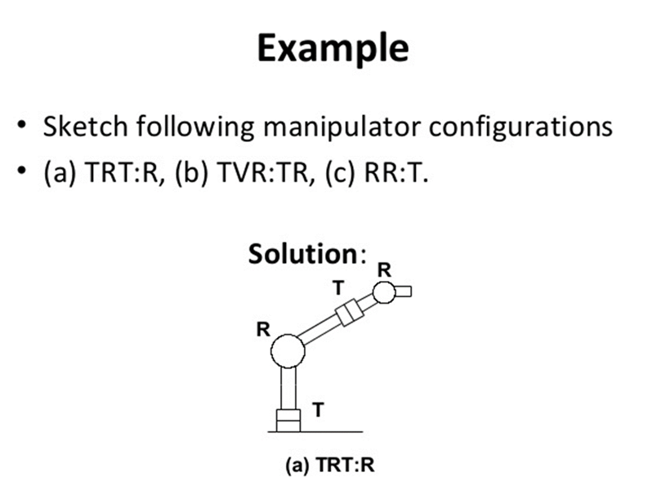
Robotics and Machine Intelligence | Week 3

Slide 25
A typical robot manipulator can be divided into two sections:
A body-and-arm assembly, and
A wrist assembly.
There are usually 3 degrees of freedom associated with the body-and-arm, and either 2 or 3 degrees of freedom usually associated with the wrist.
At the end of the manipulator's wrist is an object that is related to the task that must be accomplished by the robot. For example, the object might be a work part that is to be loaded into a machine, or a tool that is manipulated to perform some process. The body- and-arm of the robot is used to position the object and the robot's wrist is used to orient the object.
To establish the position of the object, the body-and-arm must be capable of moving the object in any of the following three directions:
Vertical motion (z-axis motion)
Radial motion (in-and-out or y-axis motion)
Right-to-left motion (x-axis motion or swivel about a vertical axis on the base)
Robotics and Machine Intelligence | Week 3

Slide 26
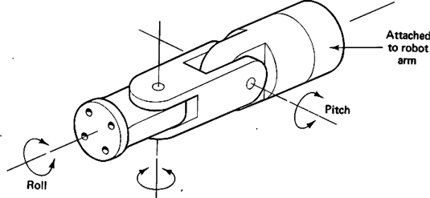
To establish the orientation of the object, we can define 3 degrees of freedom for the robot's wrist. The following is one possible configuration for a 3 D.O.F. wrist assembly:
Roll
This D.O.F can be accomplished by a T-type or “Twisting” joint to rotate the object about the arm axis.
Pitch
This involves the up-and-down rotation of the object, typically done by means of a type R or “Rotating” joint.
Yaw
This involves right-to-left rotation of the object, also accomplished typically using an R-type or “Rotating” joint.
Yaw
Typical configuration of a 3-degree-of-freedom wrist assembly showing roll, pitch, and yaw.
Robotics and Machine Intelligence | Week 3

Slide 27
ROBOT CLASSIEFICATION AND ROBOT REACH
Normally robots are classified based on their physical configurations.
Robots are also classified based on the control systems adopted.
Classification Based on Physical Configurations
Four basic configurations are identified:
Cartesian configuration;
Cylindrical configuration;
Polar configuration;
Jointed-arm configuration.
Robotics and Machine Intelligence | Week 3

Slide 28
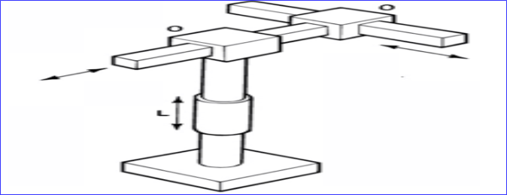
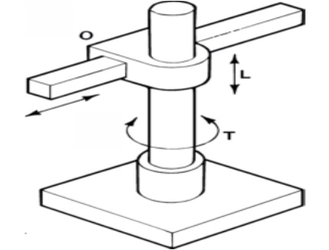
Cartesian Configuration
Robots with Cartesian configurations, consist of links connected by linear and orthogonal joints (L and O). The configuration of the robot's arm can be designated as LOO. Because the configuration has three perpendicular slides, they are also called rectilinear robots.
Cylindrical Configuration
In the cylindrical configuration, as shown below, robots have one twisting (T) joint at the base and linear (L) joints succeed to connect the links. The robot arm in this configuration can be designated as TLO. The space in which this robot operates is cylindrical in shape, hence the name cylindrical configuration.
Robotics and Machine Intelligence | Week 3

Slide 29
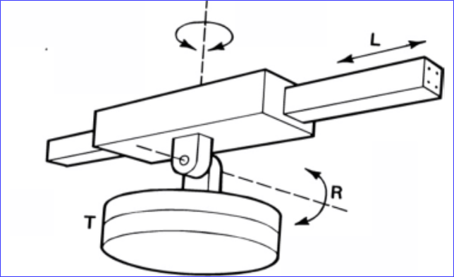
Polar Configuration
Polar robots, as shown below, have a workspace of spherical shape. Generally, the arm is connected to the base with a twisting (T) joint and rotatory (R) and/or linear (L) joints follow. The designation of the arm for this configuration can be TRL or TRR. Robots with the designation TRL are also called spherical robots. Those with the designation TRR are also called articulated robots.
Jointed-Arm Configuration
The jointed-arm configuration, is a combination of cylindrical and articulated configurations. The arm of the robot is connected to the base with a twisting joint. The links in the arm are connected by rotatory joints.
Robotics and Machine Intelligence | Week 3

Slide 30
Robot Reach
Robot reach, also known as the work envelope or work volume, is the space of all points in the surrounding space that can be reached by the robot arm or the mounting point for the end-effector or tool.
The area reachable by the end-effector itself is not considered part of the work envelope.
Reach is one of the most important characteristics to be considered in selecting a suitable robot because the application space should not fall out of the selected robot's reach.
Robotics and Machine Intelligence | Week 3

Slide 31
Robot reach for various robot configurations is shown in the following Figure.
For a Cartesian configuration, the reach is a rectangular-type space.
For a Cylindrical configuration, the reach is a hollow cylindrical space.
For a Polar configuration, it is part of a hollow spherical shape.
*A jointed-arm configuration does not have a specific geometric shape.
Robot reach (work envelope): (a) polar; (b) cylindrical robot; (c) Cartesian.
Robotics and Machine Intelligence | Week 3

